Slide 1
Parallelizing RMG with GPUs
Chris Blais

Slide 2
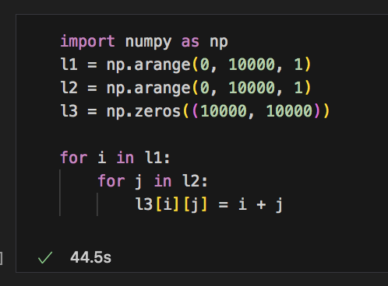
What is GPU accelleration
GPUs are better than CPUs at handling large quantities of calculations that occur simultaneously.
Mainly, this boils down to the execution of loops or nested loops on arrays. these can often be costly if done in series.

Slide 3

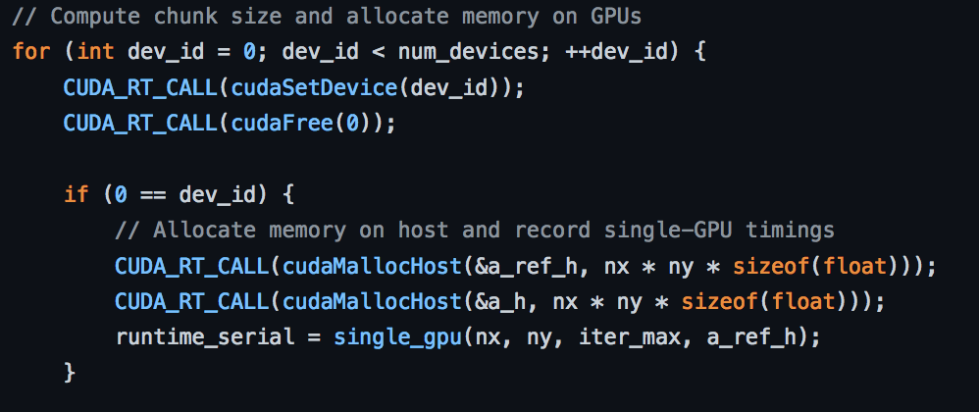
for c code, this often boils down to specifying a “formalism”
two formalisms, openacc and open mp, have a drop in statement that kindof looks like a decorator in python.
more sophisticated formalisms, like cuda, require you structurally change your variable declarations and function calls (and rename your c files .cu).

Slide 4
We proposed the following:
Our main target for speedup is the core/edge enlargement algorithm. This involves simulating a batch reactor using either a Julia or Cython script to solve the DAE system. At each time step, the fluxes of all of the edge species are calculated. If an edge species flux exceeds a characteristic rate, it is added into the model core. We are planning on parallelizing the edge species flux calculation step, which can use a majority of your overhead if you have a very large edge model.
A few notes:
some of our code is cython or Julia.
Both can use the same formalisms, but they manifest differently (Julia has a opencl.jl package that you need to install, for example)

Slide 5
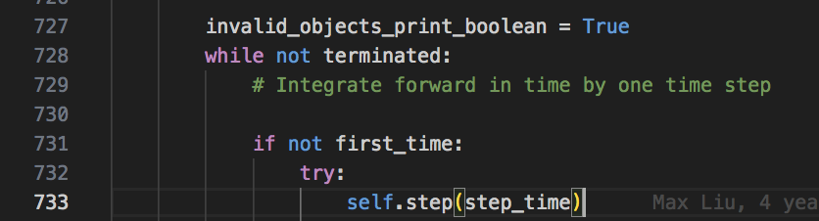
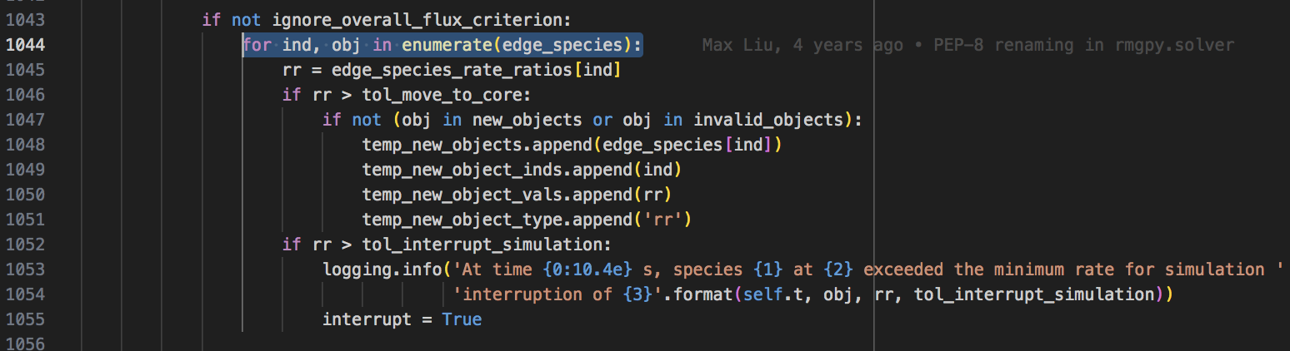
Simple reactor:
Line 733 in base.pyx
RMG reads input file
initialized model (loading databases, making rectors)
there are a number of loops that can be accelerated within this main loop, where we examine criteria for moving to the core:
run “simulate” routine from chosen reactor
generate reactions in model core/edge
Check edge species and see if they meet criteria for moving to core

Slide 6
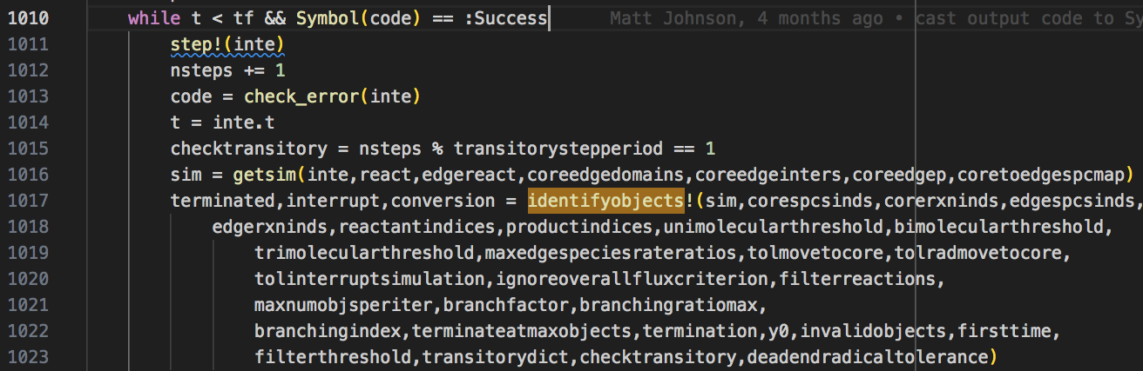
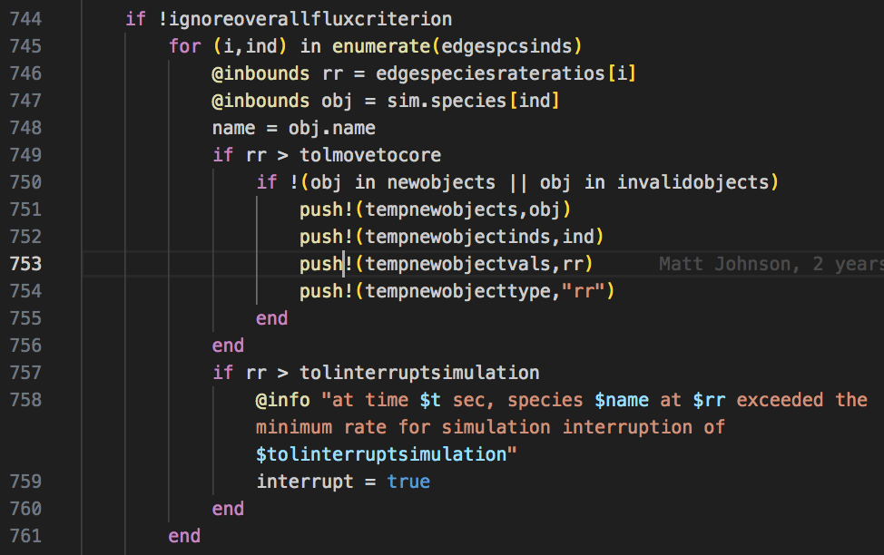
RMS Reactors
RMS has a similar execution order, with a call to “identify objects” when we want to check the core and edge species
The Identify objects has similar loop over edge species that could be parallelized

Slide 7
These are obviously not the only places we could parallelize
it provides a good starting point and a clear objective for the hackathon. if all else fails, we will at least find a way to speed this part up.
Richard had suggested the possibility of running the entire simulation (which we could parallelize) and then selecting edge species that exceed our criteria at any point in time
Flux Criteria
Flux
Time

Slide 8
What we need:
A late stage model that we can ‘restart from seed’ would be a good way to determine how much a speedup would help.
Everyone should go through the google colab, it’s not too long and hits a lot of important points
a benchmark run of rmg using cprofile/whatever is needed to profile in Julia. This is something that I will ask about at the mentor meeting.
a can-do attitude.

